Slide 1
CSc 553 Principles of Compilation 04. Code Generation
Saumya Debray
The University of Arizona
Tucson, AZ 85721

Slide 2
Overview
compiler
code generator
compiler
front end
intermediate
code
generator
final code
generator
source
program
target
program
(asm or
machine
code)
abstract syntax tree
(a tree representation
of the code structure)
three-address code
(sort of machine-
independent assembly)

Slide 3
Overview

Slide 4
Approach
Processing a function definition:
1
2
3
Intermediate Code Generation
generate 3-addr code by recursively traversing syntax tree
each AST node has a list of 3-addr instrs attached to it
list of instructions at the root of the tree is the code for the entire function
Storage Allocation
traverse the local symbol table
allocate a stack frame slot for each local and temporary
type info determines how much space to allocate
Final Code Generation
traverse the list of 3-addr instrs at the root of the function's AST
expand each 3-addr instruction into asm code
write out the code generated

Slide 5
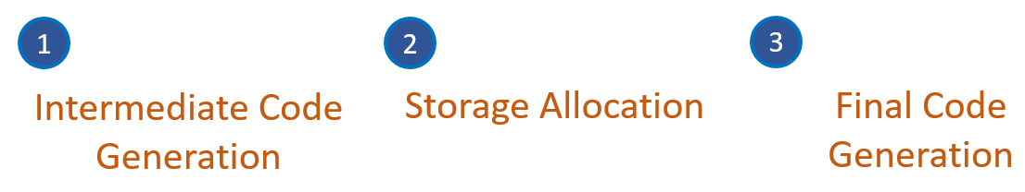
Overview: Intermediate Code Generation
Much of the work of code generation is here
To be discussed soon

Slide 6
Overview: Storage Allocation
Traverse the function's local symbol table
Allocate storage location to each ST entry based on its type
allocated as slots in the function's stack frame
respect any alignment restrictions imposed by target machine architecture
Formal parameter locations are fixed by argument position

Slide 7
Storage Allocation: Example
Stack frame structure
high addresses
int f(int x, int y, int u, int v)
{
}
var | location
x | 8($fp)
y | 12($fp)
u | 16($fp)
v | 20($fp)
p | ‒4($fp)
q | ‒8($fp)
tmp0 | ‒12($fp)
tmp1 | ‒16($fp)
rightmost actual param
leftmost actual param
old $fp
old $ra
local variables and temps
...
p
q
tmp0
tmp1
$fp →
$sp →
low addresses
→
stack growth

Slide 8
Overview: Final Code Generation
Expand each 3-addr instruction to asm
3-address code | MIPS assembly code
x = y + z | load y into reg1
 | load z into reg2
 | add reg3, reg1, reg2
 | sw reg3, x
if x ≥ y goto L | load x into reg1
 | load y into reg2
 | bge reg1, reg2, L

Slide 9
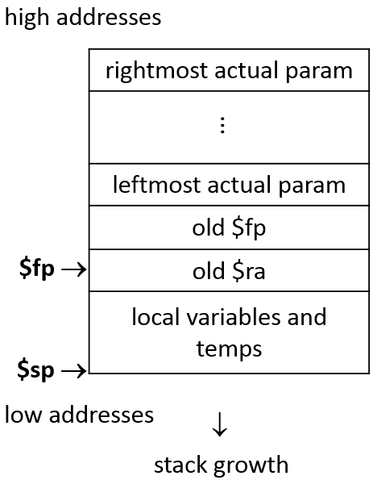
EXERCISE
Source code
3-address code
int fact(int n) {
int p = 1;
while (n > 0) {
p *= n;
n –= 1;
}
return p;
}
enter fact
p = 1
L0: if n <= 0 goto L1
tmp0 = p * n
p = tmp0
tmp1 = n – 1
n = tmp1
goto L0
L1: leave
return p
var | p | n | tmp0 | tmp1
location | ?? | ?? | ?? | ??

Slide 10
Intermediate Code Generation

Slide 11
Approach
1. identify a program construct
(from source code or syntax tree)
2. understand the runtime actions needed
3. figure out the code to do those runtime actions
4. figure out what the code generator needs to do

Slide 12
Approach
Recursively traverse the syntax tree:
Node type determines action at each node
Code for each node is a list of three-address instructions
Generate code for each node after processing its children
at each syntax tree node, create a list of instructions that executes the computation for the syntax tree rooted at the node
glue together the instructions for its children, plus code specific to that node

Slide 13
Example
tmp0 = 2
tmp1 = tmp0 * x
tmp2 = 1
tmp3 = tmp1 + tmp2
+
tmp0 = 2
tmp1 = tmp0 * x
*
1
tmp2 = 1
tmp0 = 2
2
x
‒ NULL ‒
no code needed here
list of 3-addr instructions at each node

Slide 14
Info needed for code generation
What information does an internal node need in order to generate code?
tmp3 = tmp1 + tmp2
child1 code ?
+
child2 code ?
?
?
list of 3-addr instructions at each node

Slide 15
Info needed for code generation
Each internal node needs to know:
the instruction sequence for each child
the location where the child node’s value is computed
tmp0 = 2
tmp1 = tmp0 * x
tmp2 = 1
tmp3 = tmp1 + tmp2
+
tmp0 = 2
tmp1 = tmp0 * x
*
1
tmp2 = 1
tmp0 = 2
2
x
‒ NULL ‒
no code needed here
list of 3-addr instructions at each node

Slide 16
Info needed for code generation
We augment syntax tree nodes with the following fields:
code: a list of intermediate code instructions for executing that node and its children
the address/value field [expressions only]: one of
place: the location where the expression’s value is stored at runtime
loc: the address of the location where the expression’s value will be stored at runtime (used for array elements)
the place/loc field refers to a symbol table entry for a variable or temporary
the variable/temporary is mapped to an actual memory location when going to final code
place vs. loc indicates whether or not to treat it as a pointer

Slide 17
Example
tmp0 = 2
tmp1 = tmp0 * x
tmp2 = 1
tmp3 = tmp1 + tmp2
pointers into the function’s local symbol table
code:
place: tmp3
+
tmp0 = 2
tmp1 = tmp0 * x
*
code:
place: tmp1
1
tmp2 = 1
2
code:
place: tmp0
x
tmp0 = 2
‒ NULL ‒
code:
place: x

Slide 18
Approach
codeGen_stmt(synTree_node S)
{
switch (S.nodetype) {
case FOR: … ; break;
case WHILE : … ; break;
case IF: … ; break;
case ‘=‘ : … ; break;
…
}
codeGen_expr(synTree_node E)
{
switch (E.nodetype) {
case ‘+’: … ; break;
case ‘*’ : … ; break;
case ‘–’: … ; break;
case ‘/’ : … ; break;
…
}
At each syntax tree node:
recursively process the children
then generate code for this node
then glue it all together

Slide 19
Auxiliary routines
struct symtab_entry *newtemp(typename t)
create a symbol table entry for a new temporary
return a pointer to this ST entry.
struct instr *newlabel()
return a new label instruction
struct instr *newinstr(op, arg₁, arg₂, …)
create a new instruction, fill in the arguments supplied
return a pointer to the result

Slide 20
Auxiliary routines: newtemp()
struct symtab_entry *newtemp( t )
{
struct symtab_entry *ntmp = malloc( … );
ntmp->name = …create a new name that doesn’t conflict…
ntmp->type = t;
…insert ntmp into the function's local symbol table…
return ntmp;
}

Slide 21
Auxiliary routines: newinstr()
struct instr *newinstr(opType, src1, src2, dest)
{
struct instr *ninstr = malloc( … );
ninstr->op = opType;
ninstr->src1 = src1; ninstr->src2 = src2; ninstr->dest = dest;
return ninstr;
}

Slide 22
Auxiliary routines: newlabel()
static int label_num = 0;
struct instr *newlabel()
{
return newinstr(LABEL, label_num++);
}

Slide 23
Understanding what happens at runtime
Intermediate Code Generation

Slide 24
Runtime Memory Organization (Linux)
Layout of an executing process’s virtual memory:
operating system
0xffffffff
high
addresses
random offsets
(for security)
stack
(grows downwards)
memory mapped files
(incl. dynamic libraries)
BSS segment
(uninitialized static variables; initialized to zeros)
heap
(grows upwards)
data segment
(static variables initialized by the programmer)
global data
low
addresses
code
0x00000000

Slide 25
Activation Records
An activation record contains information needed to manage a single activation of a procedure, e.g.:
saved machine state (PC, registers, return address);
actual parameter values;
local and temporary variables.
The contents of an activation record may be spread across the stack frame and registers.

Slide 26
Activation Records: Layout
Some aspects of activation record layout are specified by the calling convention. E.g.:
location of actual parameters
some machine state info
The compiler decides the layout for local variables and temporaries:
the amount of storage needed for an object is determined by its type;
storage layout must conform to any alignment restrictions of the underlying architecture.

Slide 27
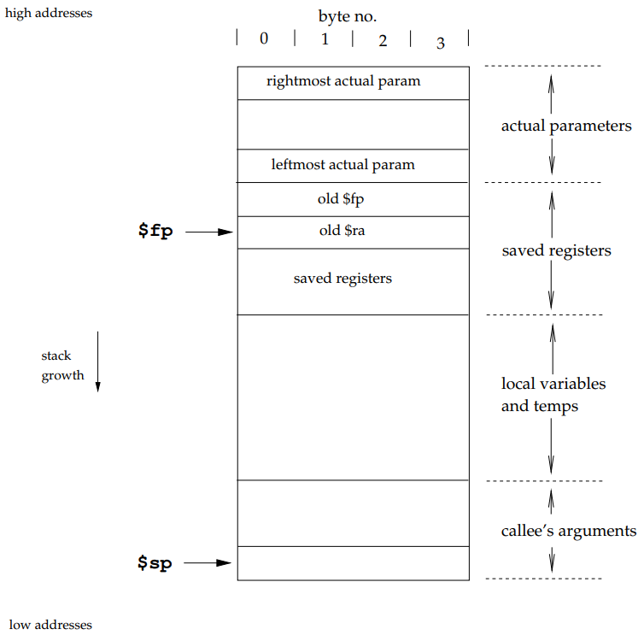
Example: Stack frame for project
stack frame

Slide 28
Procedure Calls and Returns
Calling sequence: handles a call to a procedure:
loads actual parameters where callee can find them;
saves machine state (return address, …);
branches to callee;
allocates an activation record.
Return sequence: handles the return from a procedure call:
loads the return value where the caller can find it;
deallocates the activation record;
restores machine state (saved registers, PC, etc.);
branches back to caller.

Slide 29
Calling Conventions
A calling convention for an architecture and/or language specifies how values are communicated between procedures:
register usage (e.g., caller-saved vs. callee-saved registers)
argument and return value placement
E.g.: on the x86 [C calling convention]: an integer return value is placed in register eax.
We can have multiple calling conventions, e.g.: _ _cdecl, _ _stdcall, _ _fastcall in MS Windows.

Slide 30
Caller-saved vs. Callee-saved Registers
A calling convention typically divides registers into two classes:
caller-saved: registers whose values may be overwritten by a function call
used, e.g., for scratch values
callee-saved: registers whose values will survive across a function call
used, e.g., for values inside loops that contain function calls
A function using a callee-saved register must save it on entry and restore it on exit

Slide 31
Code executed for a function call
set up function arguments
record machine state (e.g., return address)
jump to callee
calling
sequence
allocate stack frame
save machine state (e.g., return address, old frame ptr, callee-saved regs)
function
body
code for function body
set up return value (if any)
restore machine state
deallocate stack frame
return to caller
return
sequence
[clean up arguments]
retrieve return value (if any)

Slide 32
Code executed for a function call
set up function arguments
record machine state (e.g., return address)
jump to callee
calling
sequence
allocate stack frame
save machine state (e.g., return address, old frame ptr, callee-saved regs)
function
body
code generated for a function
code for function body
set up return value (if any)
restore machine state
deallocate stack frame
return to caller
return
sequence
[clean up arguments]
retrieve return value (if any)

Slide 33
Code generation for function definitions
Intermediate Code Generation

Slide 34
Code generated for function definitions
allocate stack frame
save machine state (e.g., return address, old frame ptr, callee-saved regs)
code for function body
code generated for a function
set up return value
restore machine state
deallocate stack frame
return to caller

Slide 35
Code generated for function definitions
Three-address code
allocate stack frame
save machine state (e.g., return address, old frame ptr, callee-saved regs)
enter f
// f: pointer to the function's
// symbol table entry
code for function body
generated using codeGen_stmt()
[to be discussed soon]
set up return value
restore machine state
deallocate stack frame
return to caller
leave f
// f: pointer to the function's
// symbol table entry
return

Slide 36
Examples
Source code
Three-address code
int add3(x,y,z) {
return x+y+z;
}
enter add3
… code for body of add3()…
leave add3
return tmp
pointers to symbol table entries
int max(x,y) {
if(x > y)
return x;
else
return y;
}
enter max
… code for body of max()…
leave max
return x
… code for body of max()…
leave max
return y

Slide 37
EXERCISE
What’s wrong with this code?
Source Code | 3-addr Code
int x; void init_x(y) { x = y; } | enter init_x x = y

Slide 38
EXERCISE
What 3-address code should the compiler generate?
Source Code | 3-addr Code
void myfun(void) { } | ?

Slide 39
Code generation for function calls
Intermediate Code Generation

Slide 40
Code executed for a function call
set up function arguments
record machine state (e.g., return address)
jump to callee
caller
allocate stack frame
save machine state (e.g., return address, old frame ptr, callee-saved regs)
callee
code for function body
set up return value (if any)
restore machine state
deallocate stack frame
return to caller
[clean up arguments]
retrieve return value (if any)
caller

Slide 41
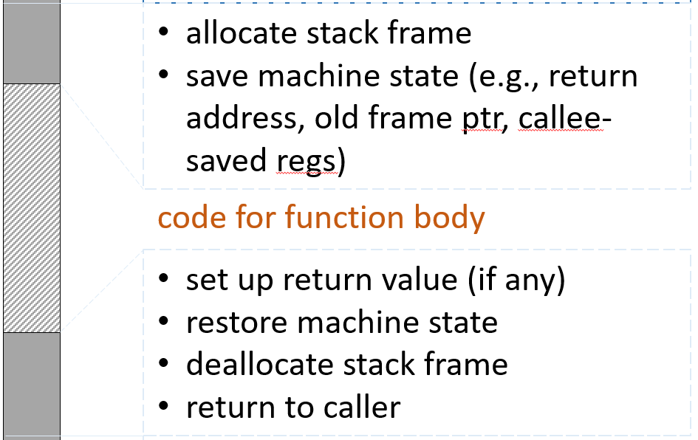
Code executed for a function call
set up function arguments
record machine state (e.g., return address)
jump to callee
caller
callee
[clean up arguments]
retrieve return value (if any)
caller

Slide 42
Code executed for a function call
Three-address code
… evaluate actuals …
param x_{k}
…
param x₁
call f, k
retrieve t0 // t0 a temporary
set up function arguments
record machine state (e.g., return address)
jump to callee
R-to-L
c a l l e r
[clean up arguments]
retrieve return value (if any)
copies the value returned into t0

Slide 43
EXERCISE
What 3-address code should the compiler generate?
Source Code | 3-addr Code
void myfun(void) { f(1,2,3); } | enter myfun param 3 param 2 param 1 call f, 3 leave myfun return

Slide 44
Code generator: Function Calls
codeGen_expr(E) /* E.nodetype == FunCall */
{
codeGen_expr(arg_list);
E.place = newtemp( f.returnType );
E.code = arg_list.code
⊕ newinstr(param, arg_{k} , NULL, NULL)
…
⊕ newinstr(param, arg₁ , NULL, NULL)
⊕ newinstr(call, f, k, NULL)
⊕ newinstr(retrieve, NULL, NULL, E.place)
}
E
FunCall
f
(sym. tbl. ptr)
arg_list
(list of expressions)
omit if return type is void
op
src1
src2
dest
/* ⊕ : list concatenation */

Slide 45
Example
Source code
Three-address code
int add3(x,y,z) {
u = add(x,y)
v = add(u,z)
return v
}
enter add3
param y
param x
call add
retrieve tmp0
u = tmp0
param z
param u
call add
retrieve tmp1
v = tmp1
leave add3
return tmp1

Slide 46
Example
Source code
Three-address code
MIPS assembly code
int add3(x,y,z) {
u = add(x,y)
v = add(u,z)
return v
}
enter add3
param y
param x
call add, 2
retrieve tmp0
u = tmp0
param z
param u
call add, 2
retrieve tmp1
v = tmp1
leave add3
return tmp1
la $sp, -8$sp
sw $fp, 4($sp)
sw $ra, 0($sp)
la $fp, 0($sp)
la $sp, -16($sp)
lw $t0, 12($fp)
la $sp, -4($sp)
sw $t0, 0($sp)
lw $t0, 8($fp)
la $sp, -4($sp)
sw $t0, 0($sp)
jal _add
la $sp, 8($sp)
...

Slide 47
l-values and r-values

Slide 48

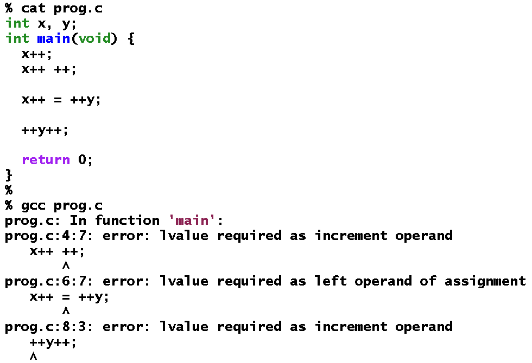
l-values and r-values
OK
not OK

Slide 49
l-values and r-values
We can only assign to (or update) expressions that correspond to locations.
Such expressions are called l-values

Slide 50
l-values and r-values
l-value: something that can appear on the left-hand side of an assignment
r-value (or simply “value”): something that can appear on the right-hand side of an assignment
Some expressions can be both l-values and r-values:
a[i] = a[i] + 1
need the location to update
need the value to update it with
When generating code, the compiler needs to know whether to compute an l-value of an r-value

Slide 51
EXERCISE
Source code: a[a[x]] = 0
At each node of the syntax tree, identify whether the value is a l-value or r-value:
=
[ ]
0
a
[ ]
a
x

Slide 52
l-values and r-values: code generation
Pass an argument to codeGen_expr() indicating whether l-value or r-value needed
codeGen_expr(expr, lr)
The generated code uses this argument to return a value of the appropriate kind
syntax tree of expression
L_value or R_value

Slide 53
Code generation for simple statements
Intermediate Code Generation

Slide 54
Assignments
Source Code: LHS = RHS
Code structure:
evaluate LHS (l-value)
evaluate RHS (r-value)
copy value of RHS into LHS
S:
=
LHS
RHS

Slide 55
Assignments
codeGen_stmt(S) /* S.nodetype == ‘=’ */
{
codeGen_expr(LHS, L_value);
codeGen_expr(RHS, R_value);
S.code = LHS.code
⊕ RHS.code
⊕ newinstr(assg, RHS.place, NULL, LHS.place) ;
}
enum indicating the
desired kind of value
S:
=
LHS
RHS
op
src1
src2
dest
if LHS is an array element or struct field, LHS.place ≡ deref(LHS.loc)

Slide 56
Type conversions
Intermediate Code Generation

Slide 57
Type conversion
Values of different types may be represented differently at the machine level
When the code to be compiled operates on values of different types, the compiler may have to insert code to convert from one representation to another
implicit type conversion: type conversion done by the compiler without explicit user input
explicit type conversion: user-directed type casting

Slide 58
Implicit type conversion: Examples
Assignments: var = exp var has a different type than exp the compiler adds code to convert the value of exp to the type of var before the assignment | Arithmetic expressions: exp1 + exp2 exp1 has a different type than exp2 the type conversion is language-specified: usually the smaller type is converted to the larger, e.g., char to int
Array indexing: A[exp] exp is not an int (e.g., a char) the compiler adds code to convert exp to an int value | Parameter passing: f(exp) exp is not the right type for parameter passing (e.g., a char) the compiler adds code to convert exp appropriately

Slide 59
Code generation for expressions I
Intermediate Code Generation

Slide 60
Expressions 1: Scalar variables
Source Code: id
Code structure:
(no code needed)
id
E

Slide 61
Expressions 1: Scalar variables
codeGen_expr(E, lr) /* E.nodetype == Var; */
{
E.place = id.loc; /* location: from symbol table */
E.code = NULL;
}
id
E

Slide 62
Expressions 2: Integer constants
Source Code: intcon
Code structure:
tmp = intcon.value
intcon
E
temporary
assigned the value of the constant

Slide 63
Expressions 2: Integer constants
codeGen_expr(E, lr) /* E.nodetype == INTCON; */
{
if (lr == L_value) {
ERROR;
}
else {
E.place = newtemp(E.type);
E.code = newinstr(assg, intcon.val, NULL, E.place);
}
}
intcon
E
op
src1
src2
dest
value of the integer constant
(computed by scanner)

Slide 64
Example
Three-address code
Source code
MIPS assembly code
x = 12
tmp0 = 12
x = tmp0
li $t0, 12
sw $t0, -4($fp)
lw $t1, -4($fp)
sw $t1, -12($fp)
.

Slide 65
Expressions 3: struct fields
Source code: A.field_{k}
Generated code needs to:
compute the address of A.field_{k}
≡ addr(A.field_{k})
access addr(A.field_{k}) (read/write as appropriate)
A
addr(A)
A.field₀
A.field₁
disp(field_{k})
A.field₂
...
A.field_{k‒1}
addr(A.field_{k})
A.field_{k}
= addr(A) + disp(field_{k})
= addr(A)
+ width(field₀)
+ width(field₁)
...
+ width(field_{k-1})
from symbol table
disp(field_{k}) can be computed by the compiler

Slide 66
Expressions 3: struct fields
codeGen_expr(E, lr) /* E.nodetype == STRUCT_REF */
{
codeGen_expr(E₁, L_value);
tmp1 = newtemp( address );
E.code = E₁.code
⊕ newinstr(plus, E₁.loc, OFFSET(E, id) , tmp1)
if (lr == L_value) {
E.loc = tmp1;
}
else { /* R_value */
E.place = newtemp( E1.id.type )
E.code = E.code ⊕ newinstr(deref, tmp1, E.place)
}
}
E ≡ E₁.id
E
.
this offset is computed by the compiler
E₁
id

Slide 67
Code generation for arithmetic operations
Intermediate Code Generation

Slide 68
Arithmetic Expressions 1: Unary Ops
Source Code: ‒ E
Code Structure:
some_loc = …value of E…
tmp = ‒ some_loc
temporary
some_loc ≡ E.place

Slide 69
Arithmetic Expressions 1: Unary Ops
codeGen_expr(E, lr) /* E.nodetype == UNARY_MINUS */
{
if (lr == L_value) {
ERROR;
}
else {
codeGen_expr(E₁, R_value);
E.place = newtemp( E.type );
E.code = E₁.code
⊕ newinstr(uminus, E₁.place, NULL, E.place);
}
}
E ≡ ‒ E₁
E
–
E₁
op
src1
src2
dest

Slide 70
Arithmetic Expressions 2: Binary Ops
Source Code: E₁ + E₂
Code Structure:
loc₁ = …value of E1…
loc₂ = …value of E2…
tmp = loc₁ + loc₂
loc₁ ≡ E₁.place
loc₂ ≡ E₂.place
temporary
contains the value of the expression

Slide 71
Arithmetic Expressions 2: Binary Ops
codeGen_expr(E, lr) /* E.nodetype == PLUS */
{
if (lr == L_value) {
ERROR;
}
else {
codeGen_expr(E₁, R_value);
codeGen_expr(E₂, R_value);
E.place = newtemp( E.type );
E.code = E₁.code
⊕ E₂.code
⊕ newinstr(plus, E₁.place, E₂.place, E.place);
}
}
E ≡ E₁ + E₂
E
+
E₁
E₂
op
src1
src2
dest
other binary arithmetic operators are similar

Slide 72
EXERCISE
Consider the statement
avg = (max + min)/2
Construct the AST for this code
Show the three-address code at each node of your AST
Based on your answer to part 2 of this problem, indicate the values of the place and code fields at each node of your AST

Slide 73
EXERCISE - solution
tmp0 = max + min
tmp1 = 2
tmp2 = tmp0 / tmp1
avg = tmp2
=
code:
place: n/a
avg
/
code:
place: tmp2
tmp0 = max + min
tmp1 = 2
tmp2 = tmp0 / tmp1
+
code:
place: tmp0
2
code:
place: min
tmp0 = max + min
tmp1 = 2
max
code:
place: max
min
code:
place: min
‒ NULL ‒
‒ NULL ‒

Slide 74
EXERCISE - solution
tmp0 = max + min
tmp1 = 2
tmp2 = tmp0 / tmp1
avg = tmp2
PLUS
op
src1
src2
dest
symbol
table
entries
max
min
tmp0
tmp1
tmp2
avg

Slide 75
EXERCISE - solution
tmp0 = max + min
tmp1 = 2
tmp2 = tmp0 / tmp1
avg = tmp2
PLUS
MOV
op
src1
src2
dest
op
src1
src2
dest
2
(null)
symbol
table
entries
max
min
tmp0
tmp1
tmp2
avg

Slide 76
EXERCISE - solution
tmp0 = max + min
tmp1 = 2
tmp2 = tmp0 / tmp1
avg = tmp2
PLUS
MOV
DIV
op
src1
src2
dest
op
src1
src2
dest
op
src1
src2
dest
2
(null)
symbol
table
entries
max
min
tmp0
tmp1
tmp2
avg

Slide 77
EXERCISE - solution
tmp0 = max + min
tmp1 = 2
tmp2 = tmp0 / tmp1
avg = tmp2
PLUS
MOV
DIV
MOV
op
src1
src2
dest
op
src1
src2
dest
op
src1
src2
dest
op
src1
src2
dest
2
(null)
symbol
table
entries
max
min
tmp0
tmp1
tmp2
avg

Slide 78
EXERCISE - solution
tmp0 = max + min
tmp1 = 2
tmp2 = tmp0 / tmp1
avg = tmp2
PLUS
MOV
DIV
MOV
op
src1
src2
dest
op
src1
src2
dest
op
src1
src2
dest
op
src1
src2
dest
2
(null)
symbol
table
entries
max
min
tmp0
tmp1
tmp2
avg

Slide 79
EXERCISE
Source code: u = x * ‒ y
Work out the 3-addr code at each node:
=
u
*
‒
x
y

Slide 80
Reusing Temporaries
Storage usage can be reduced considerably by reusing temporaries:
For each type T, keep a “free list” of temporaries of type T;
newtemp(T) uses a temp from the free list for type T whenever possible
Putting temps on the free list:
free only compiler-generated temps, not user variables
free a temp after the point of its last use (i.e., when its value is no longer neded).

Slide 81
Code generation for comparison and logical operations
Intermediate Code Generation

Slide 82
Logical Expressions
Naïve but Simple Approach (TRUE=1, FALSE=0):
tmp1 = … evaluate E₁ …
tmp2 = … evaluate E₂ …
tmp3 = 1 /* TRUE */
if ( tmp1 > tmp2 ) goto L
tmp3 = 0 /* FALSE */
L: …
>
E₁
E₂
Disadvantage: lots of unnecessary memory references

Slide 83

Logical Expressions
Observation: Logical expressions are usually used to direct flow of control.
if ( x > 0 ) {
S1
}
else {
S2
}
if ( x > 0 ) {
S1
}
else {
S2
}
while ( x > 0 ) {
S1
}
True
True
False
False
Can we generate code to do this without all the unnecessary memory operations?

Slide 84
Logical Expressions
Idea: "Tell" the code generator where the generated code should jump:
trueDst: label to jump to if expression is True
falseDst: label to jump to if expression is False
source code
generated code
if ( expr ) {
S1
}
else {
S2
}
trueDst
falseDst
trueDst
codeGen_Bool
if … goto trueDst
expr
falseDst
if … goto falseDst

Slide 85
Logical Expressions
codeGen_Bool(E, trueDst, falseDst) /* E.nodetype == '>' */
{
codeGen_expr(E₁, R_value);
codeGen_expr(E₂, R_value);
E.code = E₁.code
⊕ E₂.code
⊕ newinstr(if_gt, E₁.place, E₂.place, trueDst)
⊕ newinstr(goto, NULL, NULL, falseDst)
}
E ≡ E₁ > E₂
if_gt ≡ "if … greater than"
E
>
E₁
E₂
op
src1
src2
dest
other binary comparison operators are similar

Slide 86
Example
E.code = E₁.code ⊕ E₂.code
⊕ newinstr(if_ne, E₁.place, E₂.place, trueDst)
⊕ newinstr(goto, NULL, NULL, falseDst)
if ( x+y != 2*z ) {
S1
}
else {
S2
}
if ( x+y != 2*z ) {
S1
}
else {
S2
}
L_{true}
≠
generated code:
tmp0 = x + y
tmp1 = 2
tmp2 = tmp1 * z
if tmp0 != tmp2 goto L_{true}
goto L_{false}
L_{false}
+
*
x
y
2
z
place: tmp0
code:
tmp0 = x + y
place: tmp2
code:
tmp1 = 2
tmp2 = tmp1 * z

Slide 87
Short Circuit Evaluation
Idea: Evaluate logical expressions only to the extent necessary to determine their truth values
&&
skip if p == NULL
!=
!=
p
NULL
deref
0
p

Slide 88
Short Circuit Evaluation
Idea: Evaluate logical expressions only to the extent necessary to determine their truth values
trueDst ≡ L_{true}
&&
falseDst ≡ L_{false}
trueDst ≡ L_{true}
falseDst ≡ L_{false}
!=
trueDst
!=
falseDst ≡ L_{false}
p
NULL
deref
0
p

Slide 89
Short Circuit Evaluation
codeGen_Bool(B, trueDst, falseDst) /* B.nodetype == '&&' */
{
L₁ = newlabel( );
codeGen_bool(B₁, L₁, falseDst);
codeGen_bool(B₂, trueDst, falseDst);
B.code = B₁.code ⊕ L₁ ⊕ B₂.code;
}
B ≡ B₁ && B₂
&&
B₁
B₂
other logical operators (||, !) are analogous

Slide 90
EXERCISE
Compute trueDst and falseDst at each comparison/logical node:
||
trueDst ≡ L0
falseDst ≡ L1
label ≡ L2
<
>
label ≡ L3
trueDst ≡ ??
trueDst ≡ ??
falseDst ≡ ??
falseDst ≡ ??
x
0
x
100

Slide 91
EXERCISE
Compute trueDst and falseDst at each comparison/logical node:
&&
trueDst ≡ L0, falseDst ≡ L1
label ≡ L2
label ≡ L4
trueDst ≡ ??
||
trueDst ≡ ??
falseDst ≡ ??
!
falseDst ≡ ??
label ≡ L3
label ≡ L5
B₂
label ≡ L6
B₀
trueDst ≡ ??
B₁
trueDst ≡ ??
trueDst ≡ ??
falseDst ≡ ??
falseDst ≡ ??
falseDst ≡ ??

Slide 92
Code generation for control flow statements
Intermediate Code Generation

Slide 93
Conditionals
Source Code: if B then S₁ else S₂
Code Structure:
code to evaluate B
L_{then}: code for S₁
goto L_{after}
L_{else} : code for S₂
L_{after} : …
S:
if
B
S₁
S₂

Slide 94
Conditionals
codeGen_stmt(S) /* S.nodetype == IF */
{
L_{then} = newlabel(); L_{else} = newlabel(); L_{after} = newlabel();
codeGen_bool(B, L_{then} , L_{else});
codeGen_stmt(S₁);
codeGen_stmt(S₂);
S.code = B.code
⊕ L_{then} ⊕ S₁.code
⊕ newinstr(GOTO, NULL, NULL, L_{after})
⊕ L_{else} ⊕ S₂.code
⊕ L_{after} ;
}
S:
if
B
S₁
S₂

Slide 95
Loops 1
S:
while
codeGen_stmt(S)
{ /* S.nodetype == WHILE */
L_{top} = newlabel();
L_{body} = newlabel();
L_{after} = newlabel();
codeGen_bool(B, L_{body} , L_{after});
codeGen_stmt(S₁);
S.code = L_{top}
⊕ B.code
⊕ L_{body}
⊕ S1.code
⊕ newinstr(GOTO, NULL, NULL, L_{top})
⊕ L_{after} ;
}
B
S₁
Code Structure:
L_{top} : code to evaluate B
if ( !B ) goto L_{after}
L_{body:} code for S₁
goto L_{top}
L_{after}: …

Slide 96
Loops 2
S:
while
codeGen_stmt(S)
{ /* S.nodetype == WHILE */
L_{top} = newlabel();
L_{eval} = newlabel();
L_{after} = newlabel();
codeGen_bool(B, L_{top,} L_{after});
codeGen_stmt(S₁);
S.code =
newinstr(GOTO, NULL, NULL, L_{eval})
⊕ L_{top} ⊕ S₁.code
⊕ L_{eval} ⊕ B.code
⊕ L_{after}
}
B
S₁
Code Structure:
goto L_{eval}
L_{top:} code for S₁
L_{eval}: code to evaluate B
if ( B ) goto L_{top}
L_{after}: …
This code executes fewer branch ops

Slide 97
Handling a Sequence of Statements
S:
seq
codeGen_stmt(S) { /* S.nodetype == SEQ */
codeGen_stmt(S₁);
codeGen_stmt(S₂);
S.code = S₁.code ⊕ S₂.code
}
S₁
S₂

Slide 98
EXERCISE
Ternary expressions: E ≡ E₁ ? E₂ : E₃
?:
E₁
E₂
E₃

Slide 99
EXERCISE
Deref and load: E ≡ E₁ -> E₂
->
E₁
E₂

Slide 100
Code generation for runtime-computed addresses (Arrays)
Intermediate Code Generation

Slide 101
Expressions 4a: Array/struct variables
codeGen_expr(E, lr) /* E.nodetype == ARRAY */
{
if (lr == L_value) {
E.loc = id.loc; /* location: from symbol table */
}
else {
ERROR
}
E.code = NULL;
}
id
E

Slide 102
Expressions 4b: array references
Source code: A[i]
Generated code needs to:
evaluate i
compute address of A[i]
≡ addr(A[i])
access addr(A[i]) (read/write as appropriate)
A
addr(A)
A[0]
A[1]
A[i-1]
A[i]
disp(i)
width
...
addr(A[i])
= addr(A) + disp(i)
= addr(A) + i * width
...
from symbol table
disp(i) usually cannot be computed by the compiler
∴ need to generate code to compute it when the program executes

Slide 103
Expressions 4b: Array references
codeGen_expr(E, lr) /* E.nodetype == ARRAY_REF; */
{
codeGen_expr(E₁, R_value);
tmp1 = newtemp( int );
tmp2 = newtemp( address );
E.code = E₁.code
⊕ newinstr(mult, E₁.place, WIDTH(id.elt_type), tmp1)
⊕ newinstr(plus, id.loc, tmp1, tmp2)
if (lr == L_value) {
E.loc = tmp2
}
else { /* R_value */
E.place = newtemp( id.elt_type )
E.code = E.code ⊕ newinstr(deref, tmp2, NULL, E.place)
}
}
E ≡ id [E₁]
id’s location (from symbol table)
E
[ ]
id
E₁
displacement (in bytes) to E₁th element
address of E₁th element

Slide 104
Expressions 4b: Array references
codeGen_expr(E, lr) /* E.nodetype == ARRAY_REF; */
{
codeGen_expr(E₁, R_value);
tmp1 = newtemp( int );
tmp2 = newtemp( address );
E.code = E₁.code
⊕ newinstr(mult, E₁.place, WIDTH(id.elt_type), tmp1)
⊕ newinstr(plus, id.loc, tmp1, tmp2)
if (lr == L_value) {
E.loc = tmp2
}
else { /* R_value */
E.place = newtemp( id.elt_type )
E.code = E.code ⊕ newinstr(deref, tmp2, NULL, E.place)
}
}
compute the address of the array element
E ≡ id [E₁]
E
[ ]
id
E₁

Slide 105
Expressions 4b: Array references
codeGen_expr(E, lr) /* E.nodetype == ARRAY_REF; */
{
codeGen_expr(E₁, R_value);
tmp1 = newtemp( int );
tmp2 = newtemp( address );
E.code = E₁.code
⊕ newinstr(mult, E₁.place, WIDTH(E₁.elt_type), tmp1)
⊕ newinstr(plus, id.loc, tmp1, tmp2)
if (lr == L_value) {
E.loc = tmp2
}
else { /* R_value */
E.place = newtemp( id.elt_type )
E.code = E.code ⊕ newinstr(deref, tmp2, NULL, E.place)
}
}
E ≡ id [E₁]
E
[ ]
id
E₁
the L-value of the array element is its address
to compute its R-value, dereference its address

Slide 106
Example 1
Source code: a[x] = b[y] + 1
AST:
=
[ ]
*
a
[ ]
2
x
b
y

Slide 107
Example 1
=
L-value
R-value
[ ]
*
L-value
[ ]
R-value
2
R-value
a
R-value
x
L-value
b
R-value
y

Slide 108
Example 1
=
L-value
R-value
[ ]
loc: tmp1
code: tmp0 = x * 4
tmp1 = addr(a) + tmp0
*
L-value
[ ]
R-value
2
R-value
a
R-value
x
loc: addr(a)
code: NULL
place: x
code: NULL
L-value
b
R-value
y

Slide 109
Example 1
=
L-value
R-value
[ ]
loc: tmp1
code: tmp0 = x * 4
tmp1 = addr(a) + tmp0
dereference the l-value (address) to get the r-value (the value at that location)
*
L-value
loc: tmp4
code: tmp2 = y * 4
tmp3 = addr(b) + tmp2
tmp4 = deref(tmp3)
[ ]
R-value
2
R-value
a
R-value
x
loc: addr(a)
code: NULL
place: x
code: NULL
L-value
b
R-value
y
loc: addr(b)
code: NULL
place: y
code: NULL

Slide 110
Example 1
=
loc: tmp6
code: tmp2 = y * 4
tmp3 = addr(b) + tmp2
tmp4 = deref(tmp3)
tmp5 = 2
tmp6 = tmp4 * tmp5
L-value
R-value
[ ]
loc: tmp1
code: tmp0 = x * 4
tmp1 = addr(a) + tmp0
*
L-value
loc: tmp4
code: tmp2 = y * 4
tmp3 = addr(b) + tmp2
tmp4 = deref(tmp3)
[ ]
R-value
2
R-value
a
R-value
x
loc: addr(a)
code: NULL
place: x
code: NULL
place: tmp5
code: tmp5 = 2
L-value
b
R-value
y
loc: addr(b)
code: NULL
place: y
code: NULL

Slide 111
Example 1
loc: -
code: tmp0 = x * 4
tmp1 = addr(a) + tmp0
tmp2 = y * 4
tmp3 = addr(b) + tmp2
tmp4 = deref(tmp3)
tmp5 = 2
tmp6 = tmp4 * tmp5
deref(tmp1) = tmp6
=
loc: tmp6
code: tmp2 = y * 4
tmp3 = addr(b) + tmp2
tmp4 = deref(tmp3)
tmp5 = 2
tmp6 = tmp4 * tmp5
L-value
R-value
[ ]
loc: tmp1
code: tmp0 = x * 4
tmp1 = addr(a) + tmp0
*
L-value
loc: tmp4
code: tmp2 = y * 4
tmp3 = addr(b) + tmp2
tmp4 = deref(tmp3)
[ ]
R-value
2
R-value
a
R-value
x
loc: addr(a)
code: NULL
place: x
code: NULL
place: tmp5
code: tmp5 = 2
L-value
b
R-value
y
loc: addr(b)
code: NULL
place: y
code: NULL

Slide 112
Example 2
Source code: a[x] = b[y] (a: int, b: char)
3-address code:
tmp1 = y * 1
tmp2 = addr(b) + tmp1
tmp3 = deref(tmp2)
tmp4 = x * 4
tmp5 = addr(a) + tmp4
deref(tmp5) = tmp3
wants r-value
wants l-value

Slide 113
EXERCISE
Source code: a[ a[ u ] ] = 0
Work out the 3-addr code at each node:
=
[ ]
0
a
[ ]
a
u

Slide 114
Multi-way branches (Switch statements)
Intermediate Code Generation

Slide 115
Multi-way branches: switch statements
Goal: generate code to choose between a fixed set of alternatives based on the value of an expression
Implementation Choices:
linear search
best for a small number of case labels (≈ 3 or 4)
cost increases with no. of case labels; later cases more expensive.
binary search
best for a moderate number of case labels (≈ 4 – 8)
cost increases with no. of case labels.
jump tables
best for large no. of case labels (≥ 8)
may take a large amount of space if the labels are not clustered.

Slide 116
Background: Jump Tables
A jump table is an array of code addresses:
Tbl[ i ] is the address of the code to execute if the expression evaluates to i.
if the set of case labels have “holes”, the correspond jump table entries point to the default case.
Bounds checks:
Before indexing into a jump table, we must check that the expression value is within the proper bounds (if not, jump to the default case).
The check
lower_bound ≤ exp_value ≤ upper bound
can be implemented using a single unsigned comparison.

Slide 117
Jump Tables: cont’d
Given a switch with max. and min. case labels c_{max} and c_{min}, the jump table is accessed as follows:
Instruction
t₀ ← value of expression
t₀ = t₀ – c_{min}
if ¬(t₀ ≤_{u} c_{max} – c_{min}) goto DefaultCase
t₁ = JmpTbl_BaseAddr
t₁ += 4*t₀
jmp *t1
Cost (cycles)
…
1
4 to 6
1
1
3 to 5
∑: 10 to 14

Slide 118
Jump Tables: Space Costs
A jump table with max. and min. case labels c_{max} and c_{min} needs ≈ c_{max} – c_{min} entries.
This can be wasteful if the entries aren’t “dense enough”, e.g.:
switch (x) {
case 1: …
case 1000: …
case 1000000: …
}
Define the density of a set of case labels as
density = no. of case labels / (c_{max} – c_{min} )
Compilers will not generate a jump table if density below some threshold (typically, 0.5).

Slide 119
Switch Statements: Overall Algorithm
if no. of case labels is small (≤ ~ 8), use linear or binary search.
use no. of case labels to decide between the two.
if density ≥ threshold (~ 0.5) :
generate a jump table;
else :
divide the set of case labels into sub-ranges s.t. each sub-range has density ≥ threshold;
generate code to use binary search to choose amongst the sub-ranges;
handle each sub-range recursively.

Slide 120
Code generation for expressions II evaluation order optimization

Slide 121
Evaluation-order optimization
Goal: Choose an evaluation order for the subexpressions of an expression so as to minimize the no. of registers used
Algorithm: Given a syntax tree for an expression:
[Pass 1]: Use a postorder traversal to assign a label to each syntax tree node
The label of a node gives the max. no. of registers needed to evaluate the subexpression rooted at that node.
[Pass 2]: Traverse the expression tree and generate code, using node labels to guide which subexpression gets evaluated first

Slide 122
Labeling: Sethi-Ullman Numbering
Labeling algorithm:
if n is a leaf node:
label(n) = 1;
else:
let the labels for the children of n be l₁, l₂;
label(n) = (l₁ ≠ l₂ ? max(l₁, l₂) : l₁+1);

Slide 123
Evaluation Order: Code Generation
if n is a leaf node :
locate a free register r, and generate a load into r
else :
let the children of n be n₁ and n₂, with labels l₁ and l₂ resp.
if l₁ ≠ l₂ then : /* needs max(l₁, l₂) registers */
generate code to evaluate the subexpression with larger label
free all but one register used by that subexpression
generate code to evaluate the other subexpression
else : /* needs l₁+1 registers */
generate code to evaluate n₁ using l₁ registers
free up l₁−1 registers
use l₁ registers to evaluate n₂

Slide 124
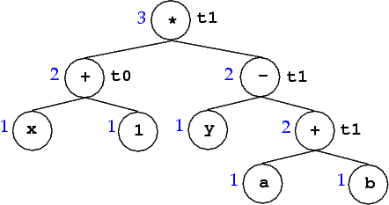
Example
Code generated (assume that ties are broken in favor of the left subexpression):
r0 = x
r1 = 1
r0 = r0 + r1
r1 = a
r2 = b
r1 = r1 + r2
r2 = y
r1 = r2 − r1
r1 = r0 + r1

Slide 125
Comments on Evaluation Order Algorithm:
O(n) in the size of the expression tree.
Easily adapted to the case where leaf node variables don’t have to be loaded into registers.
If there are no common subexpressions, the algorithm is provably optimal in terms of no. of registers used.
Optimal code generation for expression DAGs is NP-complete.
The algorithm can be adapted to handle DAGs.
This produces usually good code that is not necessarily optimal.

